Slide 1
Registration Academic Advising Meeting
March 7, 2024
(Aimed primarily at rising 2Ls)
Presented by
Kirsha Trychta
Academic Excellence Center Director & Teaching Professor
John Taylor
Associate Dean for Academic Affairs & Jackson Kelly Professor
Last Updated March 7, 2024

Slide 2
Presentation Overview
Requirements
Electives
Joint Degrees and Concentrations
Outside the Classroom Credits
Career Planning
Registration Process and Additional Resources

Slide 3
A. Requirements

Slide 4
Requirements
91 credits, with 2.50 GPA
First Year Courses (30 credits)
2L Admin Law
2L Professional Responsibility
Appellate Advocacy
Seminar course
Capstone course
No more than 26 “outside-the-classroom” credits
Full Time
9–18 credits (see next slide)

Slide 5
Enrollment Standards for Financial Aid https://financialaid.wvu.edu/home/disbursement-refunds/enrollment-standards#Standards
Enrollment Status | Fall/Spring | Summer
Full-Time | 9 or more | 6
3/4 Time | 6 to 8 | 4 to 5
Half Time | 5 | 3
Less than Half-Time | 1 to 4 | 1 to 2

Slide 6
Required: Ten First Year Courses
Civil Procedure I (4)
Criminal Law (3)
Legal Research (1)
Legal Writing I (3)
Torts I (4)
Constitutional Law I (4)
Contracts I (4)
Legal Writing II (2)
Property (4)
Professionalism (1)

Slide 7
Required: Two Second Year Courses
(3-Credit Courses Offered Every Semester)
Administrative Law 764
Professional Responsibility 742
Lawyer Ethics
Statutory interpretation
MPRE Exam (Best to take in August or November of 3L year)
Agency regulations

Slide 8
Required: Anytime in Upper-Level
Seminar
Capstone
Appellate Advocacy
Research Paper
Experiential Learning/Practice Skills
2 credits
2 credits
4 – 13 credits (depending on choice)
*Tip: Spread out these intensive courses across three semesters.

Slide 9
Required: Seminar Course
Small-sized class (cap of 15) with discussions geared toward the production of a substantial (i.e., 25+ pages) written product supported by extensive research
Offered in fall and spring semesters
Typically 2 credits
May take anytime before graduation
Must earn a grade of “C” or better
Usually red colored on the schedule grid

Slide 10
Required: Appellate Advocacy
Drafting of an appellate brief and oral advocacy of the brief, third phase of legal writing program
Offered in fall and spring semesters, and usually in the summer too
2 credits
May take anytime before graduation
Must earn a grade of “C” or better
Usually green colored on the schedule grid

Slide 11
Required: Capstone Course
Provides students with opportunity to synthesize critically and apply knowledge and skills they have developed during law school
Part of ABA experiential learning requirement
Must earn a grade of “C” or better
May take anytime before graduation
Choose From:
  Business Transaction Drafting
  Trial Advocacy, with Evidence pre-req or co-req.
  Clinic (3Ls), with potential pre-reqs or co-reqs.
  Full-time (13 credits) Judicial or Federal Agency Externship, with Evidence pre-req.

Slide 12
Clinics in Your Third Year https://www.law.wvu.edu/clinical-law/information-for-law-students
Clinic | Rule 10 Evidence + PR + GPA | Preferences
Child and Family (12 ch) | Yes | Family Law
Immigration (10 ch) | No | Immigration Law (PRE-REQ)
Innocence Project (12 ch) | Yes | Demonstrated Interest
General Practice (12 ch) | Yes | Demonstrated Interest
Veterans (12 ch) | Yes | Student Veterans
Land Use (12 ch) | No | Demonstrated Interest, Land Use Planning
Supreme Court (8 ch) | No | App Ad, Fed Courts

Slide 13
B. Electives

Slide 14
Electives
Tested on the Bar Exam
Not Tested on the Bar Exam
Non-Classroom Electives

Slide 15
Bar Exam Tested Electives
Essay & Multiple Choice
Evidence
Civil Procedure II
Criminal Procedure I (+)
Criminal Procedure II (-)
Constitutional Law II
Contracts II
Torts II
Essay Only
Business Organizations
Family Law
[Sales] & Secured Transactions*
Wealth Transfers (Wills)*
*no longer tested starting in 2026

Slide 17
Tip: Grey Courses Are Bar Tested Electives
Fall Only
Wealth Transfers
Family Law
Spring Only
Sales & Secured Transactions
Both Semesters
Crim. Pro. I
Evidence
Business Org
Prof. Resp.
Con. Law II

Slide 18
Bar Exam Preparation Workshops
Performance Test (1)
MBE Multiple Choice* (2)
MEE Essay Writing (1)

Slide 19
Tip: Each semester balance one course that you “need” to take with one course that you “want” to take
1 Fun Elective
1 Bar Tested Elective

Slide 20
C. Joint Degrees
& Concentrations

Slide 21
Joint Degrees & Concentrations https://www.law.wvu.edu/academics/academic-programs
Joint Degree Programs
  Masters in Social Work
Concentrations
  Energy and Sustainable Development Law (Eisenberg)
  Labor & Employment Law (Lofaso, Bastress)
  Public Interest (DiSalvo)

Slide 22
D. “Outside the Classroom”

Slide 23
Maximum of 26
“Outside the Classroom” Credits
Externship
Appellate Moot Court
Law Review
Indy. Study
Foreign Study
Other Grad Dept.
Online
Lugar Trial Advocacy

Slide 24
Co-Curricular Application Process
Moot Court
Tryout at end of 1L spring
2L Comp.
Lugar
Meet pre-reqs. and apply
1L Comp.
Law Review
Write On at end of 1L spring
Jessup Int’l (see Prof. Cyphert or Rodgers)

Slide 25
E. Career Planning

Slide 26
Typical Career Paths
Litigation (in the courtroom)
Transactional (drafting documents)
In-House Counsel
Judicial Clerkship
JD Preferred Career
Regulatory Compliance

Slide 27
Don’t go it alone!
Start with basic FAQs and graduation requirements
Find faculty/staff professional mentor
Plus Career Services Staff
Student Services
Faculty Mentors
Advising FAQs Sessions

Slide 28
Course Options for Criminal Law
For Example
Recommended Courses
  Criminal Procedure I: Investigation
  Criminal Procedure II: Adjudication
  Post-Conviction Remedies
  Evidence
  Civil Rights Section 1983
  Litigation Skills courses, esp. Trial Advocacy
  Innocence Clinic (or S. Ct. Clinic)
Faculty
  Kirsha Trychta, Melissa Giggenbach, Cody Corliss, John Taylor

Slide 29
F. Registration Process and Additional Resources

Slide 30
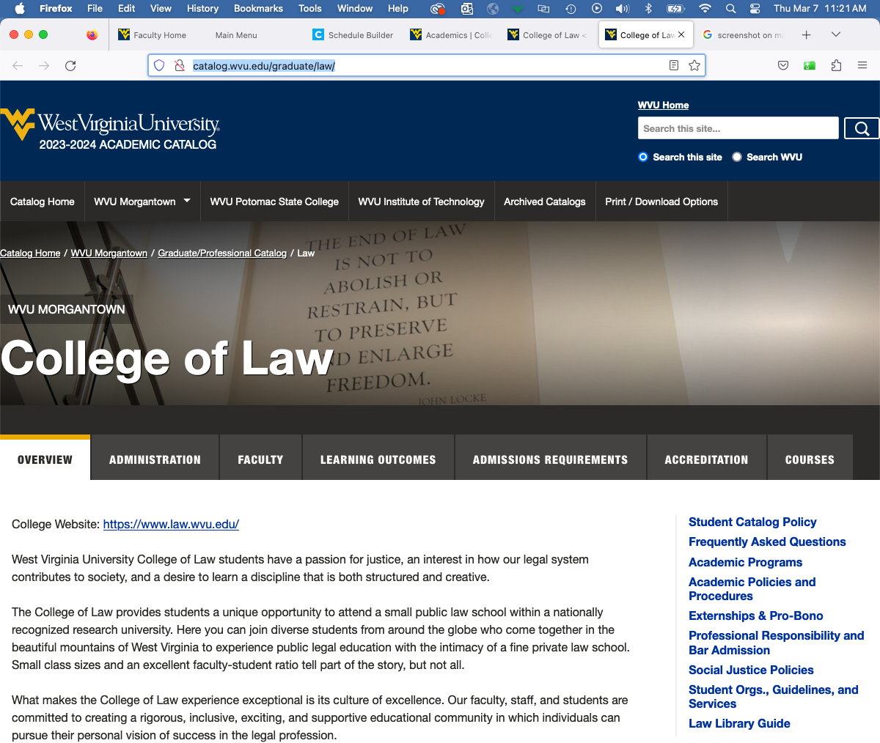
Academic Catalog
(http://catalog.wvu.edu/graduate/law/)

Slide 31
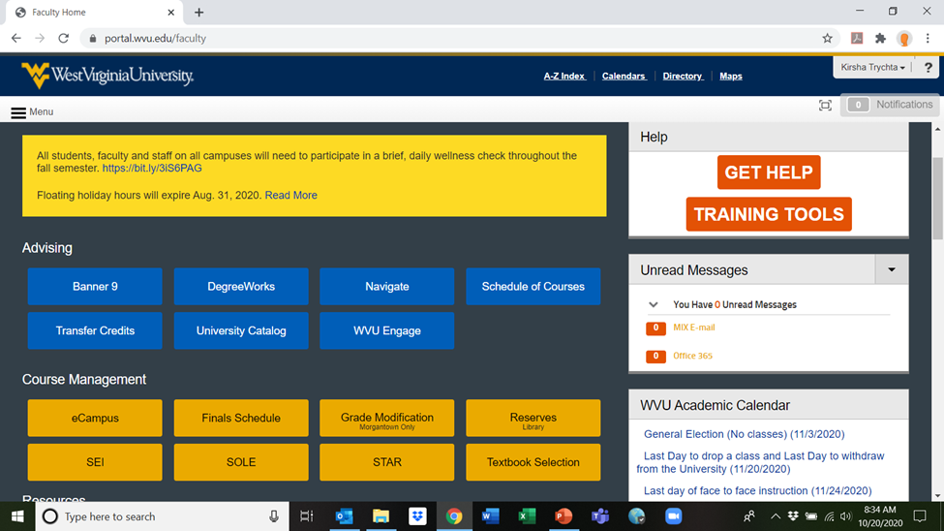
WVU Portal
(portal.wvu.edu)

Slide 32
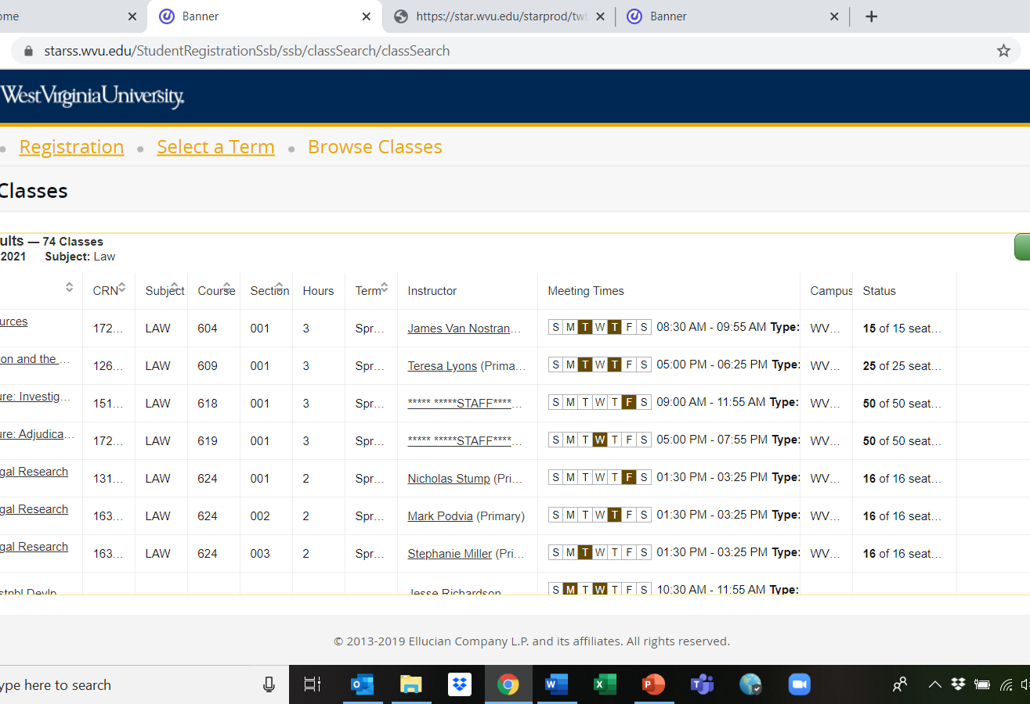
STAR Schedule of Courses
Accessible in portal or at star.wvu.edu
Select desired term
Enter “Law”
To see more on screen, uncheck “attribute” under settings wheel on left to and select “50 per page” at bottom

Slide 33
Registration Dates (And TIME!)
Upper-Level students (current 2Ls & 3Ls) register first:
Wednesday, March 20 for current 3Ls;
Thursday, March 21 for current 2Ls. 8:30am both days!
1L registration begins on Friday, March 22 at 8:30am.
Go to STAR/Schedule Builder (Next Slide)
Registration for summer and fall classes at same time
NOTE: Some course caps are hard (E.g., App Ad, seminars, skills courses like Pre-Trial); most have some wiggle room. We will monitor enrollment and raise “soft caps” as necessary.
Automated waiting lists will be set up for courses where we anticipate caps might be hit.

Slide 34
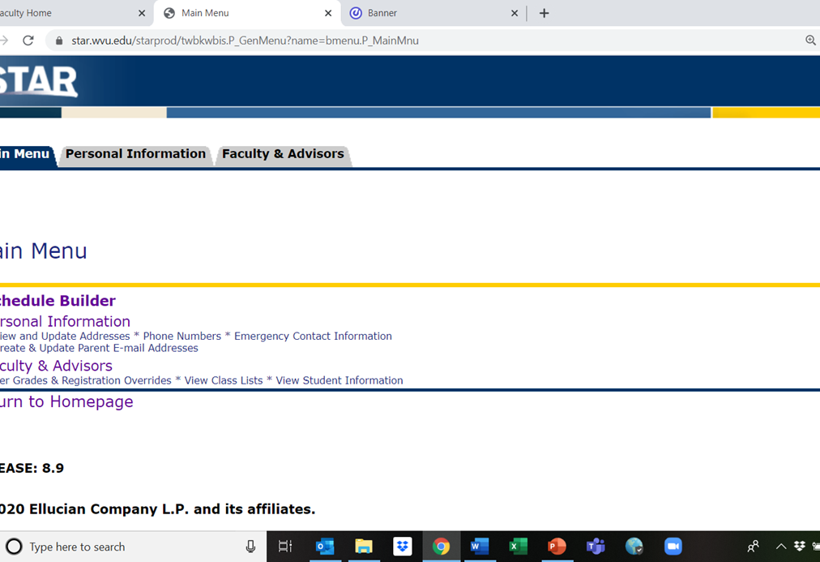
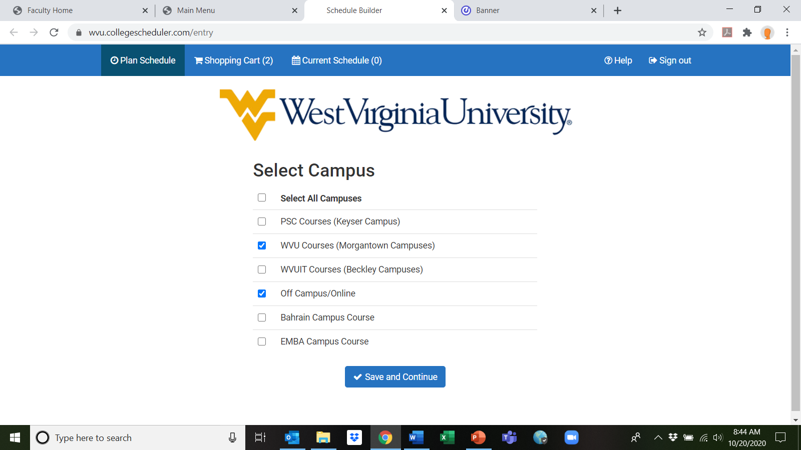
STAR Schedule Builder

Slide 35
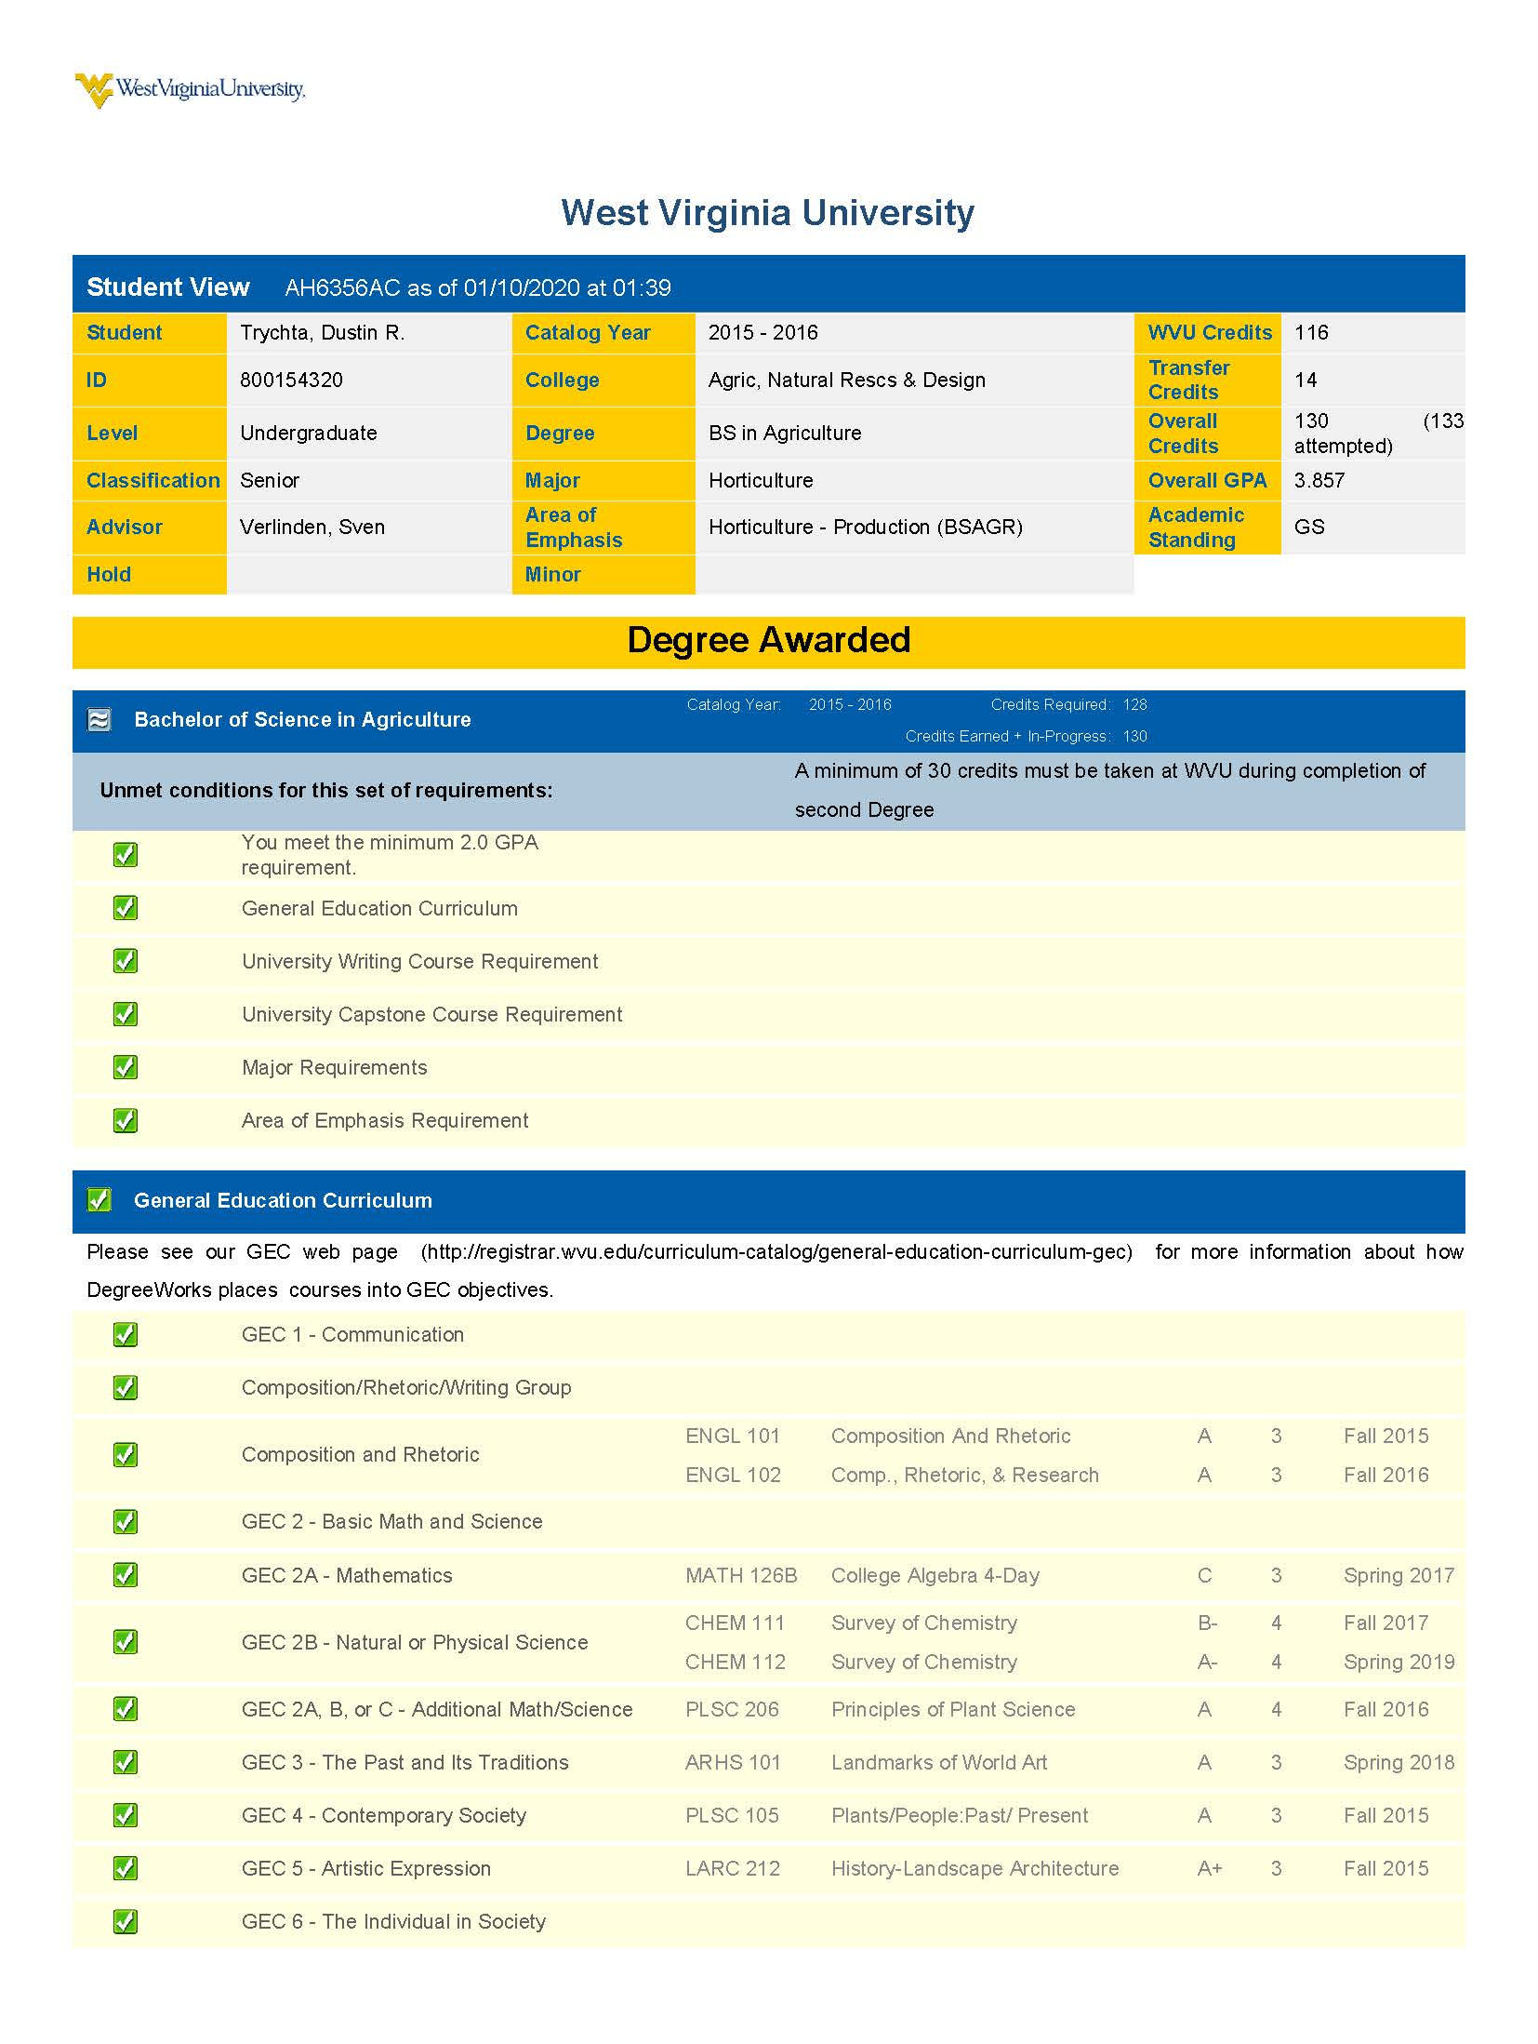
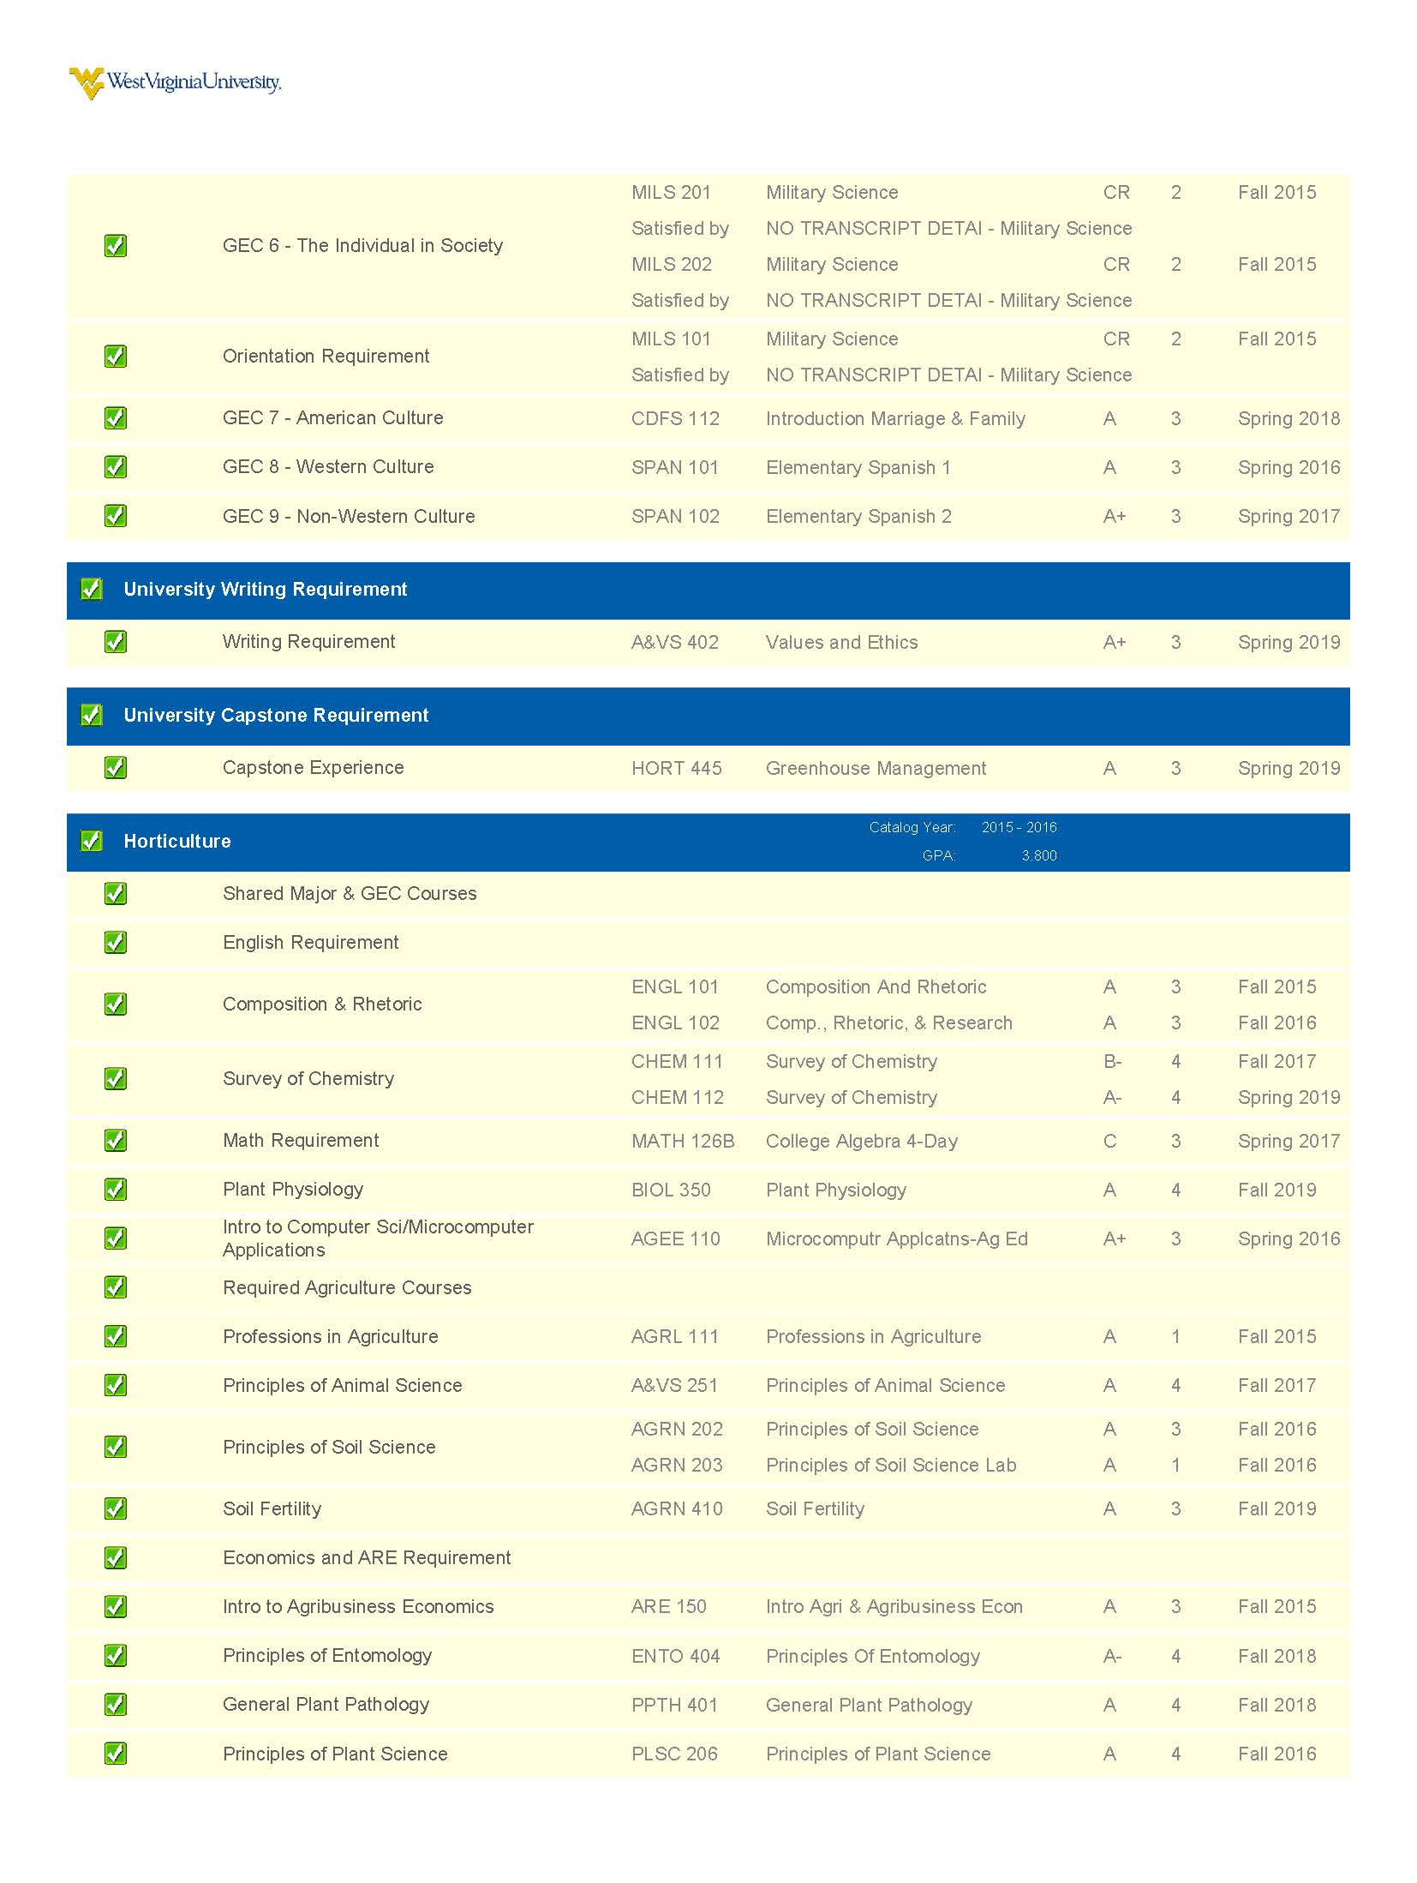
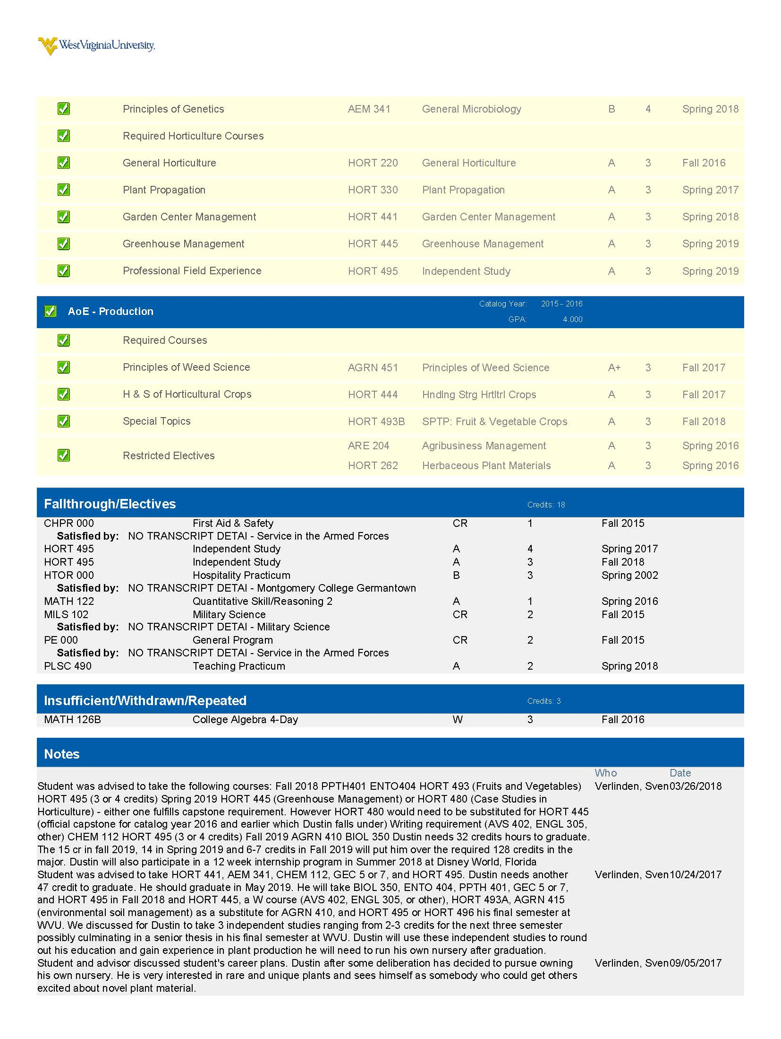
DegreeWorks: Graduation Requirements

Slide 36
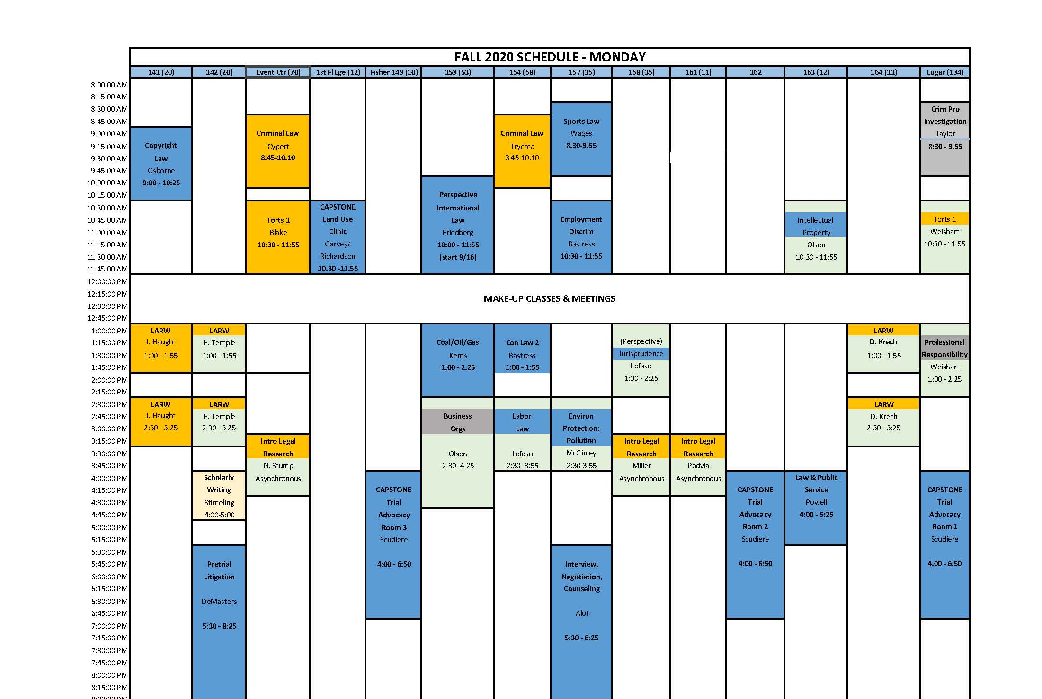
WVU Law Academics: Course Schedule & Registration https://www.law.wvu.edu/academics/course-schedule-and-registration-information

Slide 37

We’re Here to Help
Peers
Faculty/Staff Mentors
Associate Dean for Academic Affairs
Student Services Suite
Office of Accessibility Services (academic accommodations)

